Slide 1
Modern Systems Analysis and Design Eighth Edition, Global Edition Joseph S. Valacich Joey F. George
Maintaining Information Systems

Slide 2
Learning Objectives
Explain and contrast four types of system maintenance.
Describe several factors that influence the cost of maintaining an information system and apply these factors to the design of maintainable systems.
Describe maintenance management issues, including alternative organizational structures, quality measurement, processes for handling change requests, and configuration management.

Slide 3
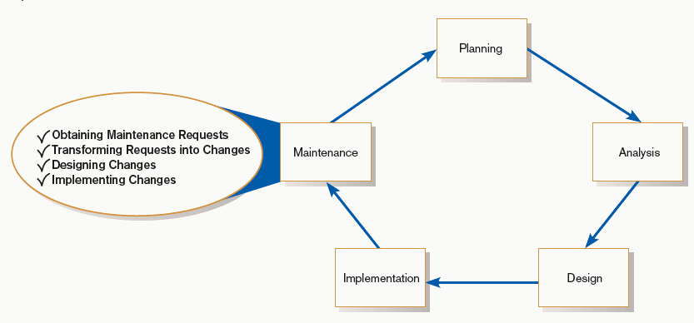
Maintaining Information Systems
FIGURE 14-1
Systems development life cycle
Notes:
At this point, the system that was developed is now operational and in use by the organization. But this doesn’t mean that the work is done. A “living” system will constantly undergo corrections, enhancements, and modifications. In this chapter we explore the details of this maintenance process.

Slide 4
The Process of Maintaining Information Systems
Process of returning to the beginning of the SDLC and repeating development steps focusing on system change until the change is implemented
Maintenance is the longest phase in the SDLC.
Notes:
This implies that the maintenance phase is like a mini-SDLC repeating over and over again, as fixes and enhancements are made to the system.

Slide 5
The Process of Maintaining Information Systems (Cont.)
Four major activities:
Obtaining maintenance requests
Transforming requests into changes
Designing changes
Implementing changes

Slide 6
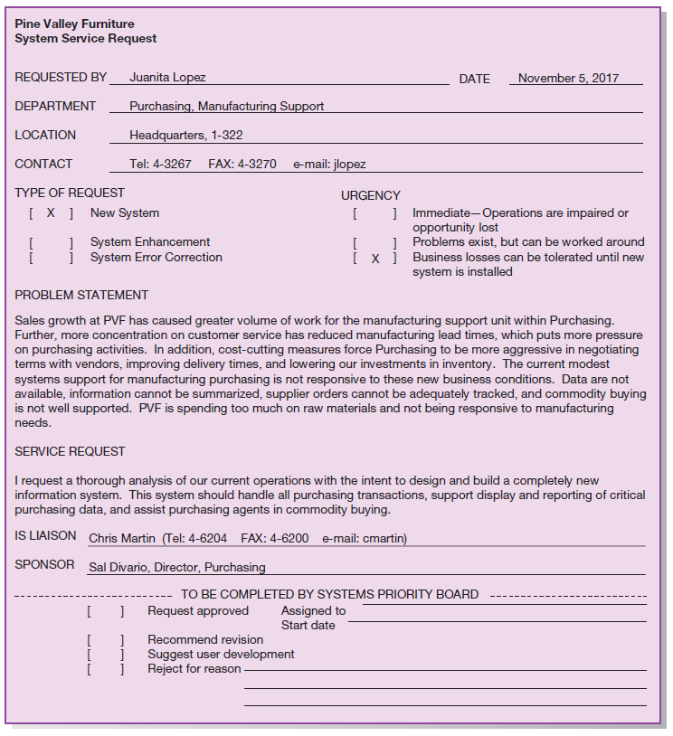
FIGURE 14-2
System Service Request for purchasing
fulfillment system (Pine Valley Furniture)
Notes:
We saw this SSR when discussing IS project management in chapter 3. Most companies have something an SSR to request new development, to report problems, or to request new features within an existing system. In chapter 3, we discussed it in the context of new systems development, but these requests are also made for system improvement and correction.

Slide 7
Deliverables and Outcome
SDLC maintenance phase is a subset of the activities of the entire development process
Development of a new version of the software and new versions of all design documents created or modified during maintenance

Slide 8
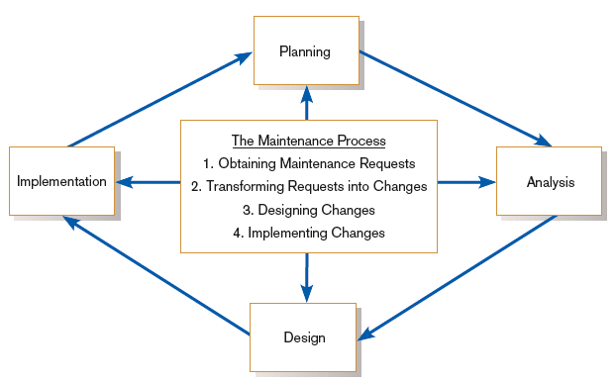
Deliverables and Outcome (Cont.)
FIGURE 14-3
Maintenance activities parallel those of
the SDLC
Notes:
This figure illustrates the concept of maintenance as a repeated SDLC cycle for making changes to existing systems.

Slide 9
Types of System Maintenance
Maintenance: changes made to a system to fix or enhance its functionality

Slide 10
Types of System Maintenance (Cont.)
Corrective maintenance: changes made to a system to repair flaws in its design, coding, or implementation
Notes:
Corrective maintenance is often urgent because the system problems detract from system effectiveness and can hurt the business.
Believe it or not, even the most thorough testing may not solve all the bugs in a system. Sometimes these bugs don’t manifest themselves until the system has been in use for months, or even years.

Slide 11
Types of System Maintenance (Cont.)
Adaptive maintenance: changes made to a system to evolve its functionality to changing business needs or technologies
Notes:
As time goes on, the requirements that led to development of the original system may change because of changing business circumstances. In this case, the system may be working perfectly fine as far as the old requirements are concerned, but new requirements lead to modification efforts.

Slide 12
Types of System Maintenance (Cont.)
Perfective maintenance: changes made to a system to add new features or to improve performance
Notes:
As users continue to work with the system, they begin to discover new possibilities and new features they might find beneficial. Perfective maintenance is done to make these improvements.
Remember when we talked about the prototyping process, and the SDLC methodologies that involve heavy user involvement? This process helped users to discover what they needed, because they were able to get some hands-on experience using system functions. The same idea applies here. The more a system is used, the more the users will envision possible new features.
This is a good thing. If a system is constantly evolving and improving, this means that the people using the system find it to actually be useful. Corrective maintenance usually comes about because of user dissatisfaction. By contrast, perfective maintenance comes about because the users like what they are using, and see possibilities for making it even better.
When you hear about “adding bells and whistles” to a system, you are hearing about perfective maintenance.

Slide 13
Types of System Maintenance (Cont.)
Preventive maintenance: changes made to a system to avoid possible future problems
Notes:
Preventive maintenance involves changes made to a system to reduce the chance of future system failure. An example of preventive maintenance might be to increase the number of records that a system can process far beyond what is currently needed, in anticipation of future increased demand.
So, whereas corrective maintenance is about fixing existing problems, preventive maintenance is about anticipating and avoiding potential future problems.

Slide 14
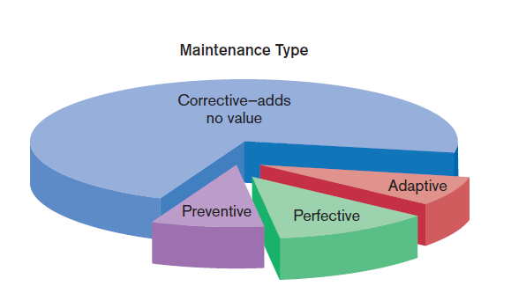
Types of System Maintenance (Cont.)
Figure 14-4
Value and non-value adding of different types of maintenance (Sources: Based on Andrews and Leventhal,1993; Pressman, 2005.)
Notes:
As you can see here, most maintenance is corrective. What this means is that most systems have existing flaws when they are put into production. There is no value-added here, simply fixing problems. Sad but true.
Another way of looking at the distinction between these four types of maintenance is this. Corrective deals with the effects of the past. Preventive, perfective, and adaptive deals with our expectations of and hopes for the future.

Slide 15
The Cost of Maintenance
Many organizations allocate 60-80% of information systems budget to maintenance.
Maintainability: the ease with which software can be understood, corrected, adapted, and enhanced
Notes:
Maintainability should be a concern for developers from the very beginning of the SDLC. When planning, analyzing, designing, and implementing a new system, careful consideration should be given to ensuring that the system will be as easy and cost-effective as possible to maintain.

Slide 16
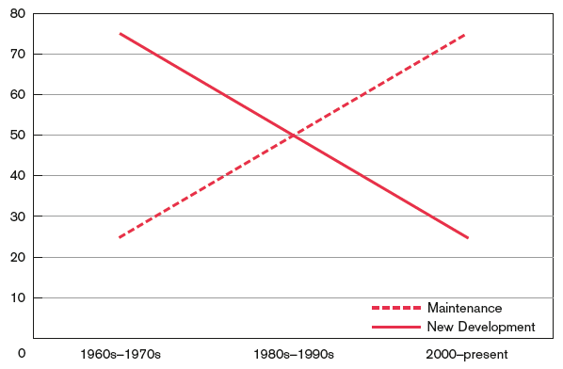
The Cost of Maintenance (Cont.)
FIGURE 14-5
New development versus maintenance as
a percentage of the software budget over the years
(Source: Based on Pressman, 2005.)
Notes:
Initial development of a system can, of course, be quite costly. But this is small compared to the accrued cost over time of maintaining an existing system.

Slide 17
The Cost of Maintenance (Cont.)
Factors influencing maintainability
Latent defects: unknown errors after installation (increases corrective maintenance).
Nbr. of system customers: more customers ➔ more (and conflicting) maintenance requests
Quality of system documentation: lack of documentation makes maintenance harder
Maintenance personnel: high quality programmers required for maintenance
Tools: automated documentation and code tools
Well-structured programs: good quality of code makes maintenance easier

Slide 18
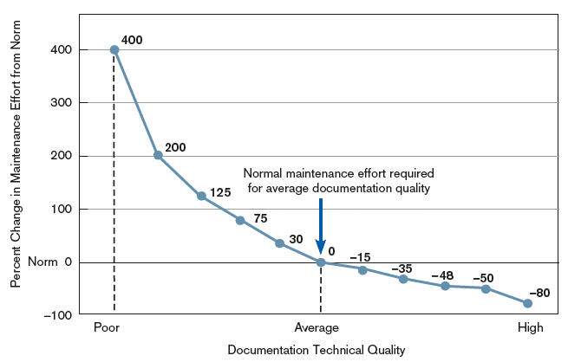
The Cost of Maintenance (Cont.)
FIGURE 14-6
Quality documentation eases Maintenance
(Source: Based on Hanna, M. 1992.
“Using Documentation as a Life-Cycle Tool.” Software Magazine [December]: 41–46.)
Notes:
This graphic shows that there is a significant impact on documentation quality on ease of maintenance. Look at the graph. On the poor end, the effect is severe. You can see an exponential relationship between documentation quality and ease of maintenance, and this is especially striking in the left half of the graph. What this graph says is that if your documentation quality is high, maintenance is easy, and even if the quality is only average, maintenance isn’t that bad. But with poor quality documentation, maintenance is a nightmare.

Slide 19
Managing Maintenance Personnel
Traditionally, maintenance and development were separately staffed.
Organizations are rethinking this. Maybe combine development and maintenance into one role?
Another possibility: spread maintenance personnel in different functional units (marketing, accounting, human resources, etc.)
Notes:
The question we’re addressing is how to organize and staff maintenance tasks. Maintenance is often not considered as fun or rewarding or creative as development, but as we saw earlier it is just as important and can be more costly over time.

Slide 20
Managing Maintenance Personnel (Cont.)
Three possible organizational structures:
Separate — maintenance group consists of different personnel than development group
Combined — developers also maintain systems
Functional — maintenance personnel work within the functional business unit
Notes:
Here’s the breakdown we just talked about in a list.

Slide 21
Managing Maintenance Personnel (Cont.)
Maintenance Organization Type | Advantages | Disadvantages
Separate | Improved system and documentation quality | Ignorance of critical undocumented information
Combined | Maintenance group knows all about system | Less emphasis on good documentation
Functional | Personnel have vested interest | Limited job mobility and human or technical resources
Notes:
There are advantages and disadvantages of each type of organization.

Slide 22
Measuring Maintenance Effectiveness
Must measure the following factors:
Number of failures
Time between each failure
Type of failure
Notes:
We just talked about organization and staffing for maintenance .It’s also important to be able to assess and measure maintenance effectiveness. Measurement of maintenance activities is fundamental to understanding the quality of these efforts.
These three measures are quantifiable, and relatively straightforward to track. Obviously you want to minimize the number of failures and maximize the time between failures. It’s also useful to understand which types of failures are most frequent.

Slide 23
Measuring Maintenance Effectiveness (Cont.)
Mean time between failures (MTBF): a measurement of error occurrences that can be tracked over time to indicate the quality of a system
Notes:
This is a very common measure. The larger the MTBF the better.

Slide 24
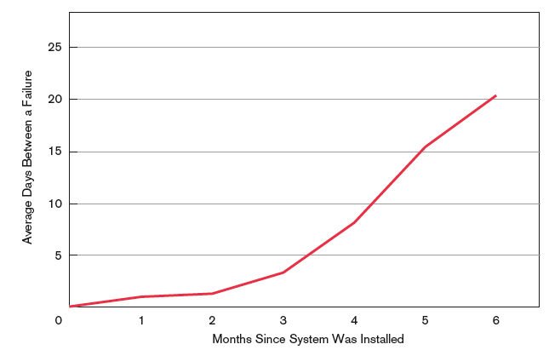
Measuring Maintenance Effectiveness (Cont.)
FIGURE 14-7
How the mean time between failures
should change over time
Notes:
At first, you may have relatively frequent failures. These are hopefully addressed with corrective maintenance actions over time, and after a while the MTBF should increase significantly.

Slide 25
Controlling Maintenance Requests
Maintenance requests can be frequent.
Prioritize based on type and urgency of request.
Evaluations are based on feasibility analysis.
Notes:
In addition to organization and measurement, management of maintenance requires you to control which maintenance tasks to do and when. This is similar issue as the project prioritization and scheduling we talked about in chapter 4.

Slide 26
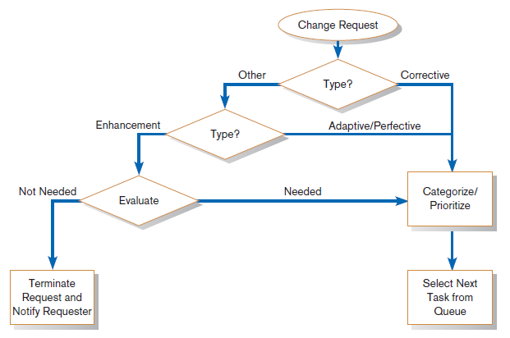
Controlling Maintenance Requests (Cont.)
FIGURE 14-8
How to prioritize maintenance requests
Notes:
This flow chart gives a good decision-making guide. Corrective and adaptive/perfective are categorized and queued. Enhancements are evaluated for usefulness and need before being prioritized with the others. Obviously, some maintenance requests will be more urgent or important than others.

Slide 27
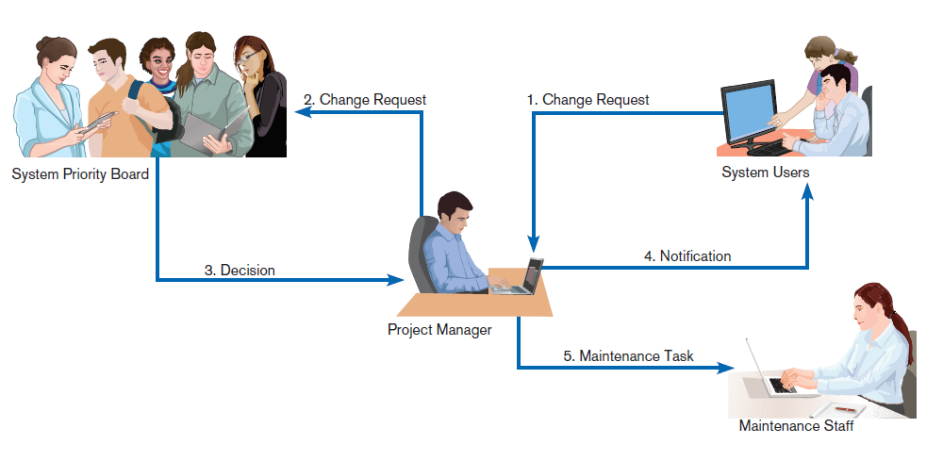
Controlling Maintenance Requests (Cont.)
FIGURE 14-9
How a maintenance request moves
through an organization
Notes:
This flow of maintenance requests is similar in many respects to the project request and selection process we talked about in earlier chapters. Recall that these were part of the SDLC’s Planning phase. So, again, we see that maintenance is a bit like a mini-SDLC; what’s happening here is like some of the planning elements of the SDLC.

Slide 28
Web Site Maintenance
Special considerations:
24 X 7 X 365
Nature of continuous availability makes maintenance challenging.
Pages under maintenance can be locked.
Consider using date and time stamps to indicate when changes are made instead.

Slide 29
Web Site Maintenance (Cont.)
Check for broken links
HTML Validation
Pages should be processed by a code validation routine before publication.
Reregistration
When content significantly changes, site may need to be reregistered with search engines.

Slide 30
Web Site Maintenance (Cont.)
Future Editions
Consistency is important to users.
Post indications of future changes to the site.
Batch changes.

Slide 31
Summary
In this chapter you learned how to:
Explain and contrast four types of system maintenance.
Describe several facts that influence the cost of maintaining an information system and apply these factors to the design of maintainable systems.
Describe maintenance management issues, including alternative organizational structures, quality measurement, processes for handling change requests, and configuration management.

